Slide 1

One in the Spirit Retreat
WELCOME to our

Slide 2

Opening Prayer 1
+ All-powerful God,
Father of our Lord Jesus Christ,
by water and the Holy Spirit
you freed your sons and daughters
from sin and gave us new life.
Send your Holy Spirit upon us to be our
helper and guide.
Lord, give us wisdom to see our talents
and affirm your gifts in others.
Lord, give us understanding so that we may know our part in the ministry of the Church…

Slide 3
Opening Prayer 2
Lord, give us counsel to make decisions that will lead us closer to you.
Lord, give us fortitude that we may spread the good news with joy, enthusiasm and love
and travel the journey simply, freely
and with a vision rooted in you….
Lord, give us knowledge to believe
that whatever we are at this moment
is planned by you and that the seeds of your life will grow in us.

Slide 4
Opening Prayer 3
Lord, give us piety that, like Mary,
we can say yes to the unknown
and come to cherish all that is holy
and sacred in life.
Lord, give us fear of the Lord
to lay our needs before you
and leave the rest to you.
Lord, fill us to the brim
so that those who come into our lives
will experience your mercy,
compassion and love. We ask this through Christ us Lord. Amen. +

Slide 5
Session 1: Building Community
What is your favorite
birthday memory?
What is the farthest distance away from home that you have traveled?
When you were a kid, what did you want to be when you grew up?
What is your favorite way to relax?

Slide 6
Session 1: Building Community
What is a gift or talent that
you could share with the
Church?
What brings you joy? Why do you think it brings you such joy?
Tell the group about someone who has shown you what it means to be a Catholic-Christian.

Slide 7
Session 2: Catholic Community
What is community?
Why is community important?
Why is community especially important for Christians?

Slide 8
Session 2: Catholic Community
Community | Did you feel like you belonged and were appreciated? | List any Good Experiences you recall: | What made them Good Experiences for you?
Family
Sports Team
Club or Activity (Band, 4-H, etc.)
Group of Friends
School
Church
Your Experiences
of Community

Slide 9

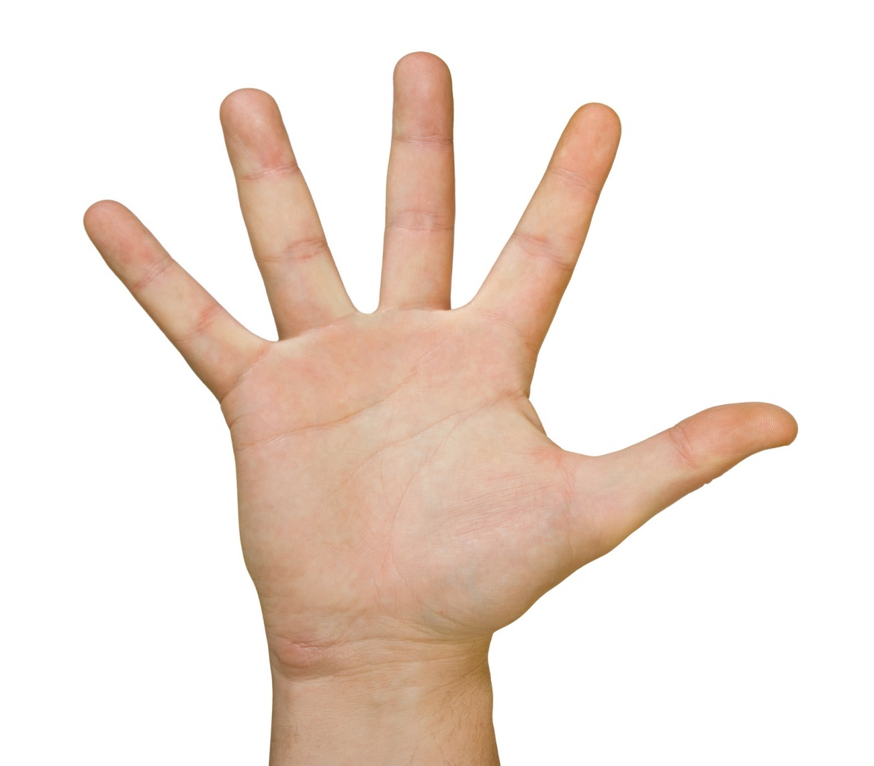
Session 2: Catholic Community
Catholic Community
Transformational Communion
The Christian Community as Mystical Body of Christ
Love of the Poor
Trinity:
God as community
Sharing Our Gifts

Slide 10

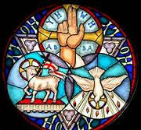
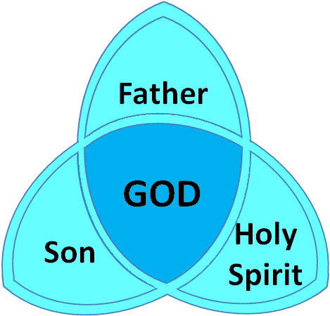

Session 2: Catholic Community
Trinity: Community is Deeply Connected to Mystery of God

Slide 11
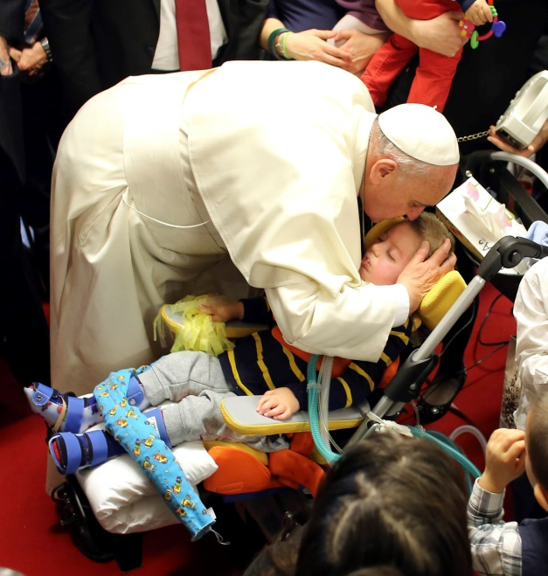
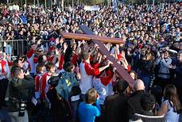
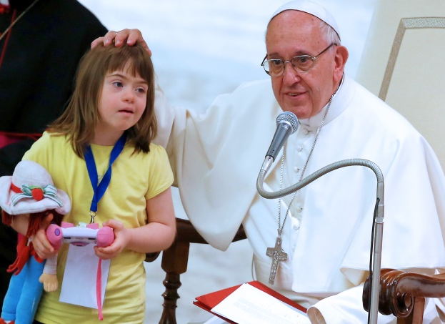
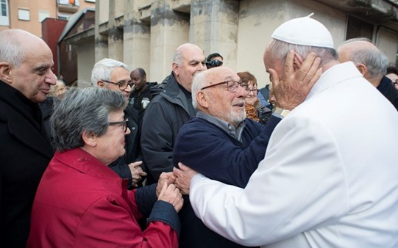
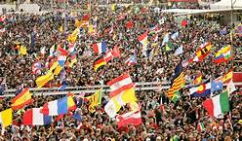

Session 2: Catholic Community
The Christian Community is the Mystical Body of Christ

Slide 12
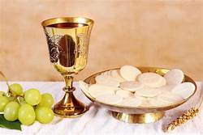
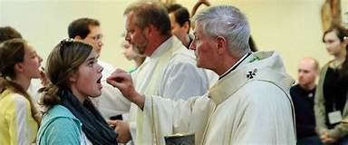

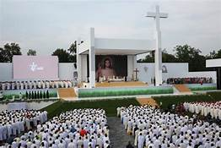
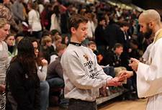
Session 2: Catholic Community
Transformational
Communion

Slide 13
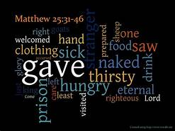
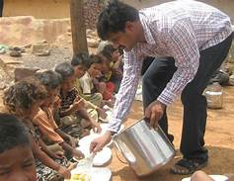
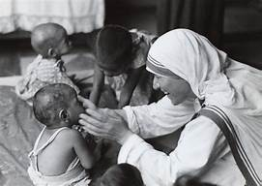
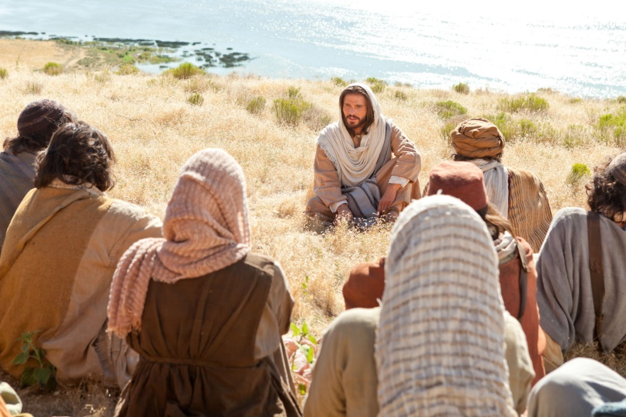
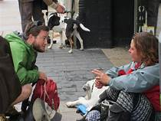

Session 2: Catholic Community
Love of the Poor

Slide 14
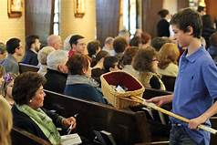
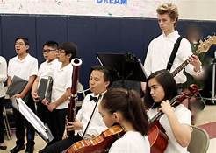


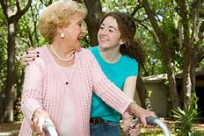
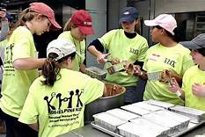
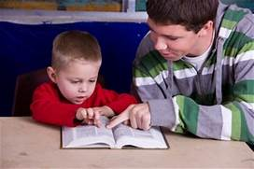
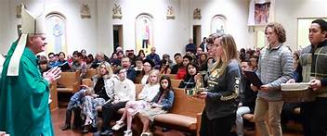
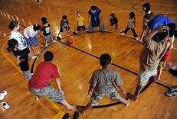
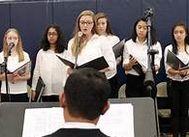
Session 2: Catholic Community
Sharing One’s Gifts

Slide 15


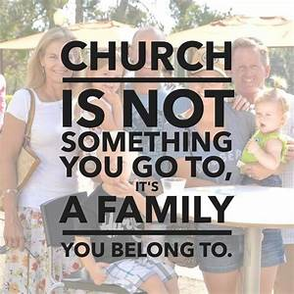
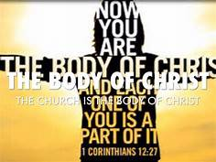
Session 2: Catholic Community
You are an
essential
member

Slide 16

Session 2: Catholic Community
Catholic Community
Transformational Communion
The Christian Community as Mystical Body of Christ
Love of the Poor
Trinity:
God as community
Sharing Our Gifts

Slide 17

Session 2: Catholic Community
+In the name of the Father, and of the Son, and of the Holy Spirit. Amen.
R. We are the
Body of Christ.

Slide 18
Session 3: Our Local Church
6 OHIO Dioceses:

Slide 19
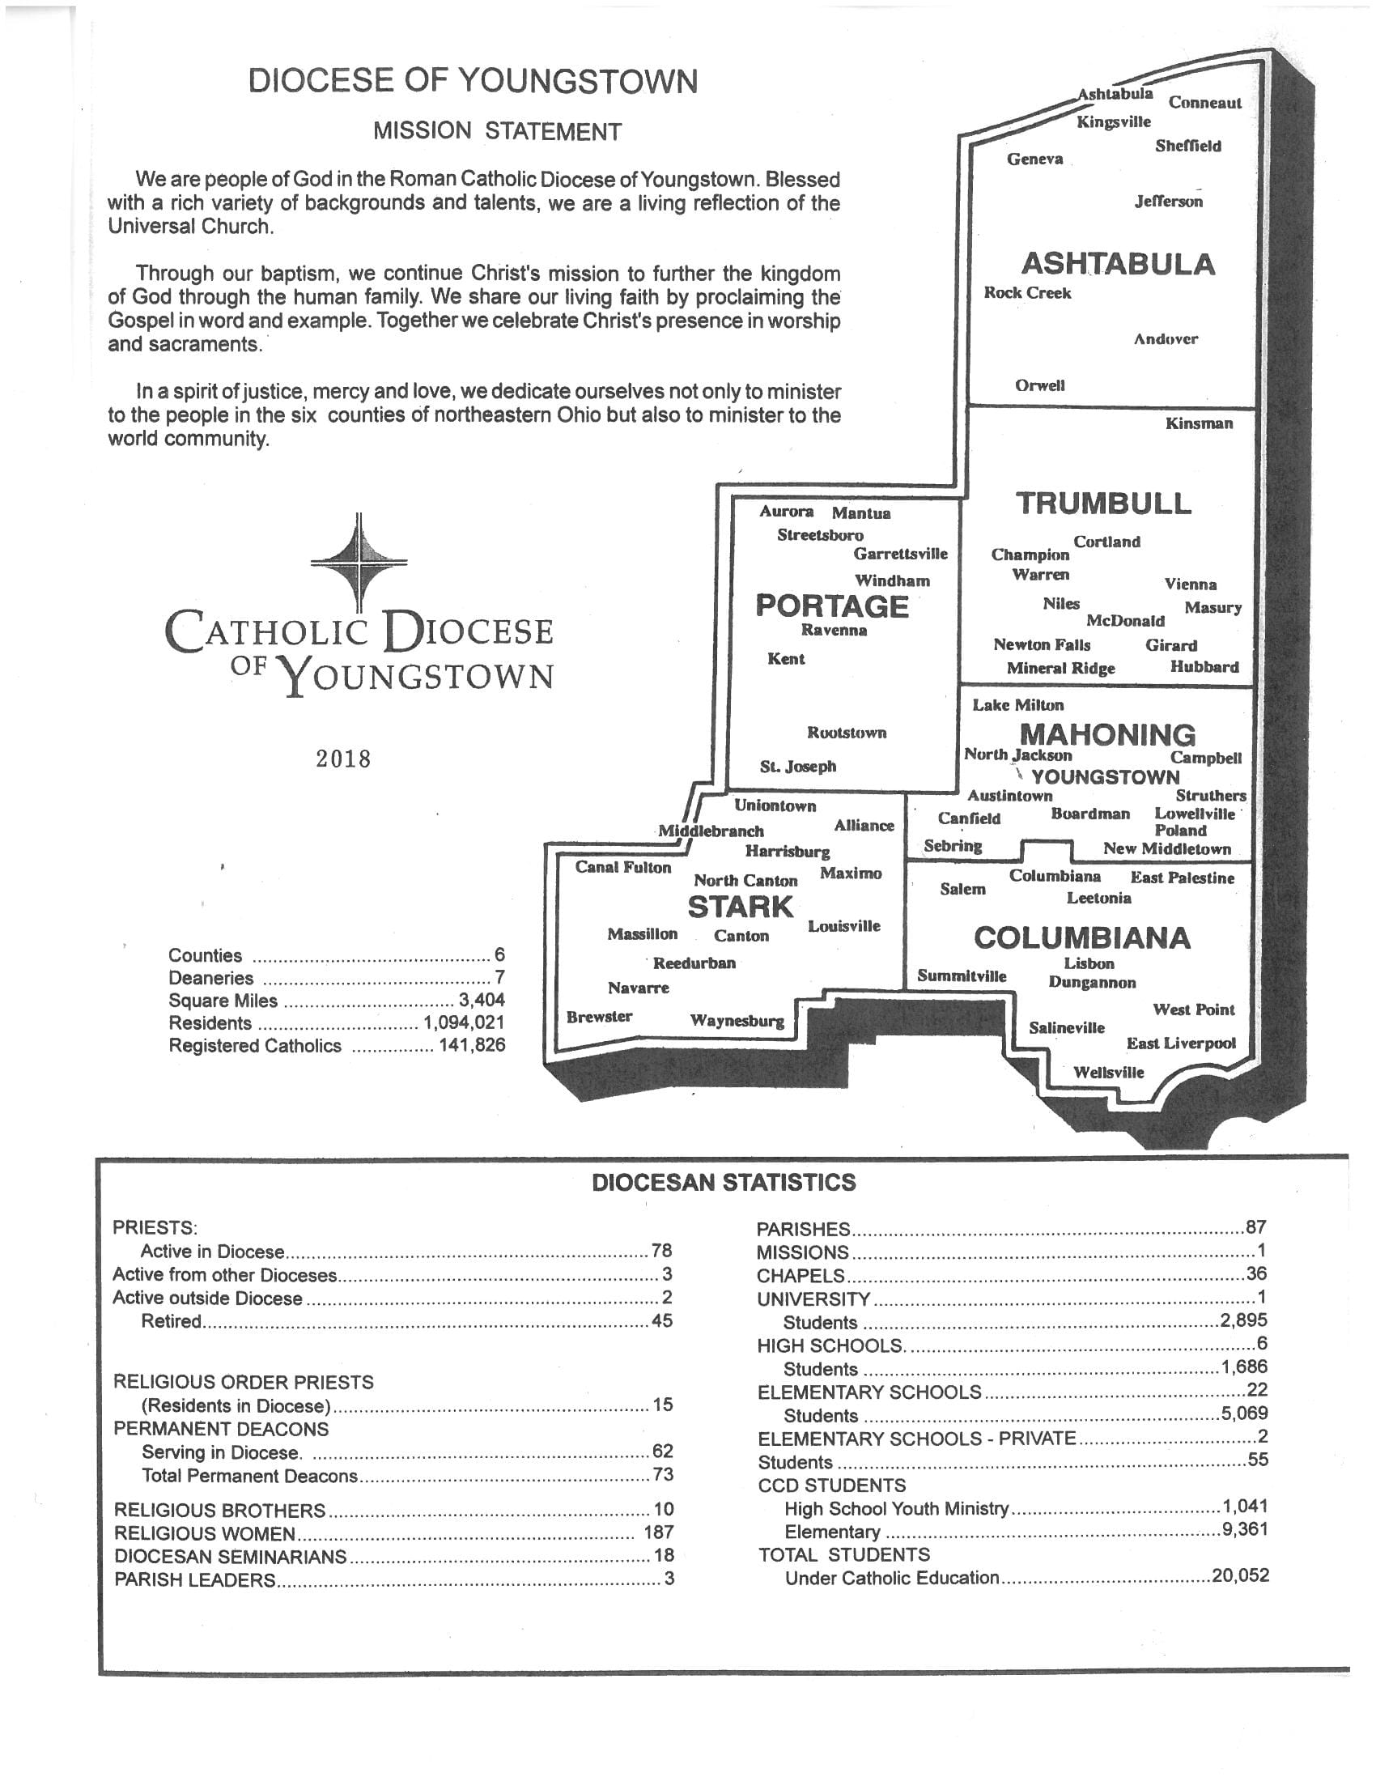
Session 3: Our Local Church

Slide 20
Session 3: Our Local Church
Number of Counties in the Diocese of Youngstown: | Year the Diocese of Youngstown was established: | Number of Catholic High Schools in the Diocese of Youngstown:
Number of Active Priests in the Diocese of Youngstown: | Number of Catholic Elementary Schools in the Diocese of Youngstown? | Catholic Population in the Diocese of Youngstown:
Number of Parishes in the Diocese of Youngstown: | Number of Catholic Universities in the Diocese of Youngstown: | Total population in the counties of the Diocese of Youngstown:

Slide 21
Videos
Session 3: Our Local Church
Diocesan Anniversary Video (10.5 minutes): https://www.youtube.com/watch?time_continue=1&v=xawEoHYt340
Followed by the video(s) for your county
Ashtabula: https://www.youtube.com/watch?time_continue=4&v=zdjiMFt8Rw8
Columbiana: https://www.youtube.com/watch?v=onqZZpTCr3o
Mahoning: https://www.youtube.com/watch?time_continue=1&v=jov9B_d7dQE
Portage: https://www.youtube.com/watch?v=f5i7_rcMIH0
Stark: https://www.youtube.com/watch?time_continue=1&v=0HqvCAn5zt4
Trumbull: http://doy.org/index.php/diocesan-offices/ctny/188-audio-a-video
If also want to watch Cathedral video:
https://www.youtube.com/watch?time_continue=2&v=x-cjm0ESL_Q

Slide 22

Reflect
Session 3: Our Local Church
What did you learn while watching the videos and discussing our Local Church?
Imagine May 15, 2043, when the Diocese of Youngstown celebrates its’ Centennial, how do you think you will have contributed to the ‘building of the Church’ by then?
What do you need to do in the next year or two to lead towards this faith-filled future?

Slide 23
Break and Ice-breaker

Slide 24
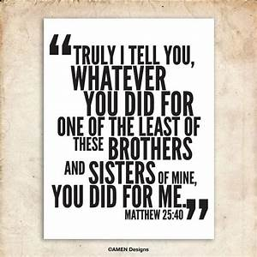
Session 4: Our Global Church

Slide 25

A Reading from the Gospel of Matthew:
[Jesus] withdrew in a boat to a deserted place by himself.
The crowds heard of this and followed him on foot from their towns. When he disembarked and saw the vast crowd, his heart was moved with pity for them, and he cured their sick. When it was evening, the disciples approached him and said, “This is a deserted place and it is already late; dismiss the crowds so that they can go to the villages and buy food for themselves.” [Jesus] said to them, “There is no need for them to go away; give them some food yourselves.” But they said to him, “Five loaves and two fish are all we have here.” Then he said, “Bring them here to me,” and he ordered the crowds to sit down on the grass. Taking the five loaves and the two fish, and looking up to heaven, he said the blessing, broke the loaves, and gave them to the disciples, who in turn gave them to the crowds. They all ate and were satisfied, and they picked up the fragments left over — twelve wicker baskets full. Those who ate were about five thousand men, not counting women and children.

Slide 26
Session 4: Our Global Church
What words or images come to mind when you think of hunger?
How would you define hunger?
Why do you think there is so much hunger in the world?

Slide 27

“What good is it, my brothers, if someone says he has faith but does not have works? Can that faith save him? If a brother or sister has nothing to wear and has no food for the day, and one of you says to them, “Go in peace, keep warm, and eat well,” but you do not give them the necessities of the body, what good is it?” (James 2: 14 – 16)
HUNGER
Living on less than $2 per day

Slide 28
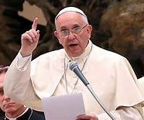

Pope Francis:
“Consumerism has led
us to become used to
an excess and daily
waste of food, to which,
at times, we are no longer able to give
a just value, which goes well beyond mere economic parameters. We should all remember, however, that throwing food away is like stealing from the tables of the poor, the hungry!”
(General Audience, June 5, 2013)

Slide 29
Session 4: Our Global Church
We can begin to fight
global hunger by not wasting food.
How can you cut back on food waste this week?
How can you be a more mindful consumer?

Slide 30

Session 4: Our Global Church
+ In the name of the Father, and of the Son, and of the Holy Spirit ...
Loving and gracious God,
When the obedient widow had given her family’s last bit of flour to Elijah,
You fed them.
When you called your sons and daughters out of bondage, You fed them.
When faced with the hunger of the 5,000,
With nothing save a few gracious handfuls offered up by a child, You fed them…

Slide 31
Time and again, you have foreshadowed the bread of salvation
By nourishing us with the bread of this world.
Lord, you filled the fishermen’s nets to bursting. Fill us to bursting.
Fill us with compassion for our sisters and brothers...

Slide 32

Session 4: Our Global Church
…Fill us with the grace that pours forth from your loving heart.
Fill us with obedience to your last commandments:
To go forth into the world
To do for others as you have done for us
To feed your sheep.
So many are hungry, And we are hungry too. In our weariness, our complacency, our cynicism, We have grown hungry for your compassionate spirit. Fill us to bursting. Amen. +

Slide 33

Session 5: Living As Church
Living As Church
The Talk Show

Slide 34
Session 5: Living As Church
YOUR TURN:
How might YOU use
your Gifts of the Holy Spirit
…in the parish,
  …with your peers,
    …in your families,
    …in our neighborhoods
    and other communities
        …and with the larger Church?

Slide 35
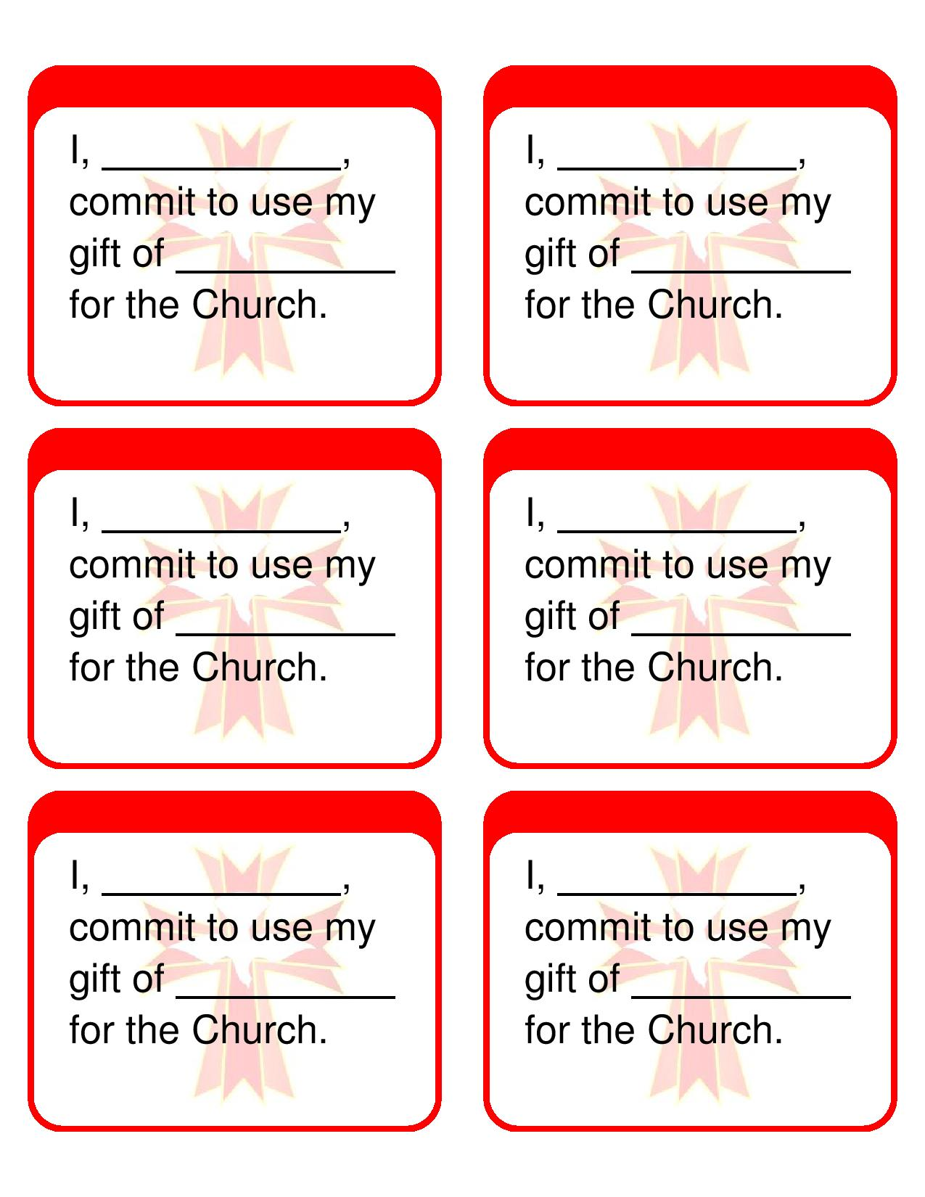
Please complete and turn in your
Commitment Card.

Slide 36
Videos
Session 5: Living As Church
It Is NOT Graduation!
https://youtu.be/NVsOgyTxQcM
Bishop George V. Murry, S.J. addresses the Confirmation Candidates: https://www.youtube.com/watch?v=gA5iqOqK3q8

Slide 37
Closing Prayer
Closing Prayer Service for Confirmation Retreat
Call to prayer
Leader: Jesus promised that whenever we gather in his name, he is in our midst. With this in mind, we begin with the Sign of the Cross.
All: + In the name of the Father, and of the Son and of the Holy Spirit, Amen.
Leader: Let us bow our heads and remember that the Lord is with us in this moment of prayer. (Pause)…. We ask you this, who lives and reigns forever and ever.
ALL: Amen.
Song
Scripture Reading: Acts 8: 5-8, 14-17
Prayer to the Holy Spirit Reflection

Slide 38
Blessing of Senses Responses:
Reading 1: All one shining light.
Reading 2: All one flowing water.
Reading 3: All one living plant.
Intercessions
Response: Lord, Hear Our Prayer.

Slide 39
Closing Blessing
Leader: God our Father made us his children by water and the Holy Spirit. May God bless us…
May almighty God bless us, the Father and the Son and the Holy Spirit.
ALL: Amen
Leader: Go in peace, continuing to grow in the gifts and blessings God has bestowed upon us at Baptism and are continually strengthened by the power of the Holy Spirit.
ALL: Thanks be to God.

Slide 40
Prayer for the 75th Anniversary of the Diocese of Youngstown
(2018 – 2019)
Good and gracious God,
we give thanks for your abundant blessings
throughout these past seventy-five years.
With pride in the past and faith in the future,
we place our trust in you.
With your grace and wisdom,
we embrace our missionary discipleship
guided by the Holy Spirit.
May we spread the Joy of the Gospel
as we look forward to our 100th anniversary;
we ask this through Christ our Lord.
Amen.
St. Columba, pray for us.

