Slide 1
Come, Holy Spirit, fill the hearts of your faithful...
Diocese of Youngstown
Day of Prayer and Preparation
August 29, 2019

Slide 2
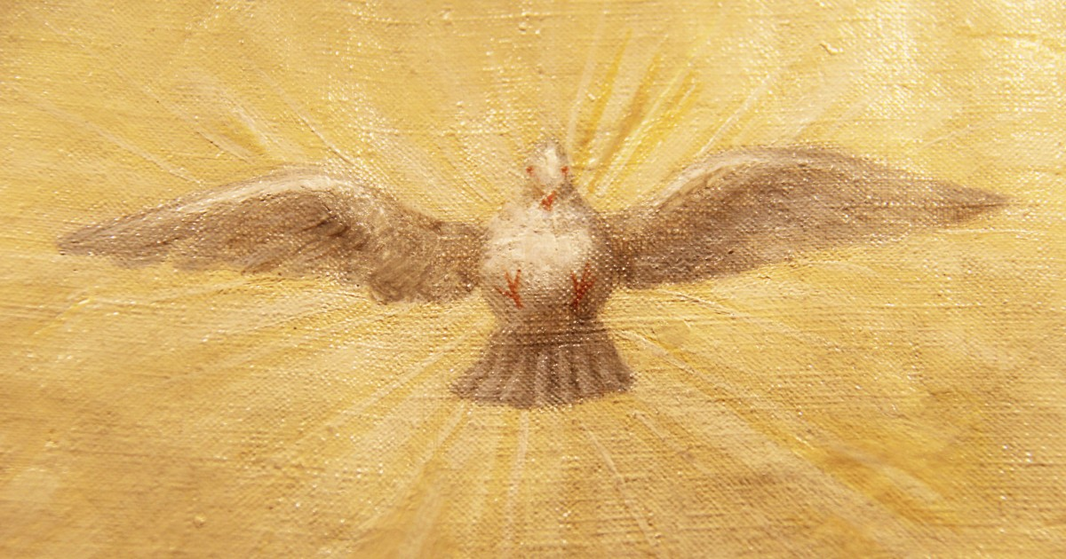
Saint Augustine’s Prayer to the Holy Spirit
Breathe in me, Holy Spirit, that my thoughts may all be holy.

Slide 3
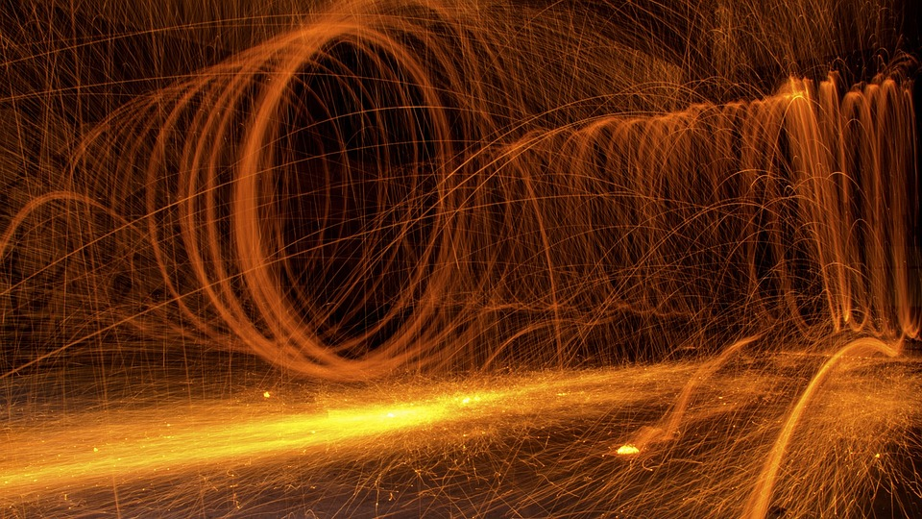
Move in me, Holy Spirit, that my work, too, may be holy.

Slide 4
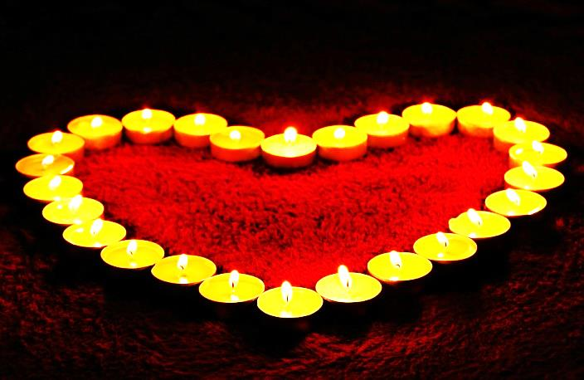
Attract my heart, Holy Spirit, that I love only what is holy.

Slide 5
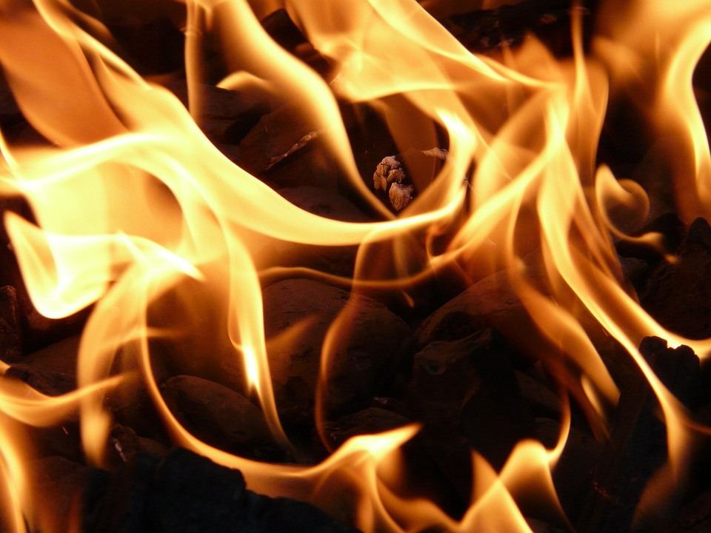
Strengthen me, Holy Spirit, to defend all that is holy.

Slide 6
Protect me, Holy Spirit, that I may always be holy.

Slide 7
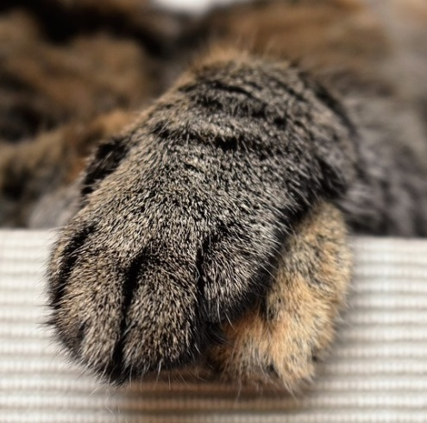
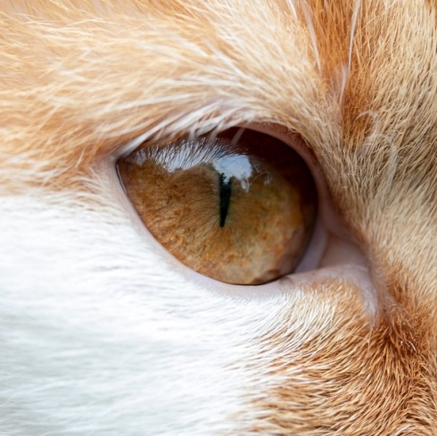
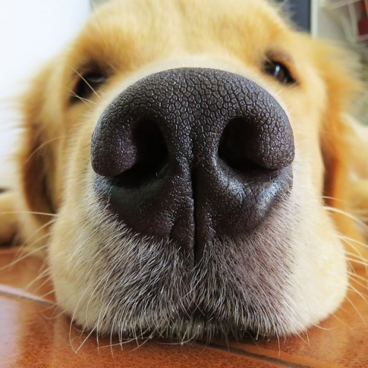
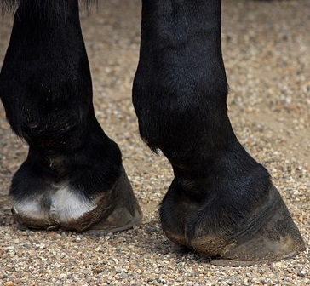
2 2 3
4 5 ALL

Slide 8
Lord, send out your Spirit
Lord, send out your Spirit, and renew the face of the earth.
Bless the Lord, Bless the LORD, O my soul! O LORD, my God, you are great indeed! How manifold are your works, O LORD! the earth is full of your creatures;
Lord, send out your Spirit, and renew the face of the earth. May the glory of the LORD endure forever; may the LORD be glad in his works! Pleasing to him be my theme; I will be glad in the LORD.
Lord, send out your Spirit, and renew the face of the earth. If you take away their breath, they perish and return to their dust. When you send forth your spirit, they are created, and you renew the face of the earth.
Lord, send out your Spirit, and renew the face of the earth.

Slide 9
We Are Many Parts
We are many parts, we are all one body,
and the gifts we have we are given to share.
May the Spirit of love make us one indeed;
one the love that we share,
one our hope in despair,
one the cross that we bear.
God of all, we look to you, we would be your servants true,
let us be your love to all the world.
So my pain is pain for you, in your joy is my joy, too;
all is brought together in the Lord.
All you seekers, great and small, seek the greatest gift of all;
if you love, then you will know the Lord.
- Marty Haugen

Slide 10
We Are Called
1. Come! live in the light! Shine with the joy and the love of the Lord! We are called to be light for the kingdom, to live in the freedom of the city of God! Refrain: We are called to act with justice. We are called to love tenderly. We are called to serve one another, to walk humbly with God. 2. Come! Open your heart! Show your mercy to all those in fear! We are called to be hope for the hopeless, so hatred and blindness will be no more! 3. Sing! Sing a new song! Sing of that great day when all will be one! God will reign and we'll walk with each other as sisters and brothers united in love!

Slide 12
REFLECT:
What are you going to bring
to this new ministry year
that will help to kindle the fire of love?

