Slide 1
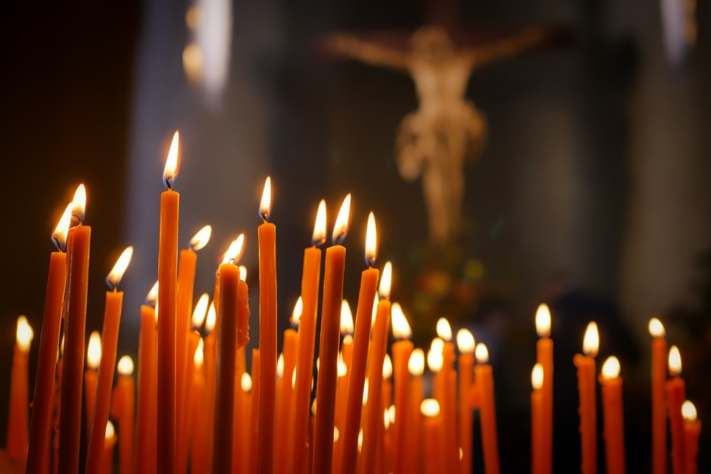
Welcome!
Day of Prayer and Preparation

Slide 2
(STAND) Find someone you don’t know well
Name
Ministry
What is one way you have felt the Holy Spirit working in your life?

Slide 3
Go to Mentimeter on your phone
CODE

Slide 4
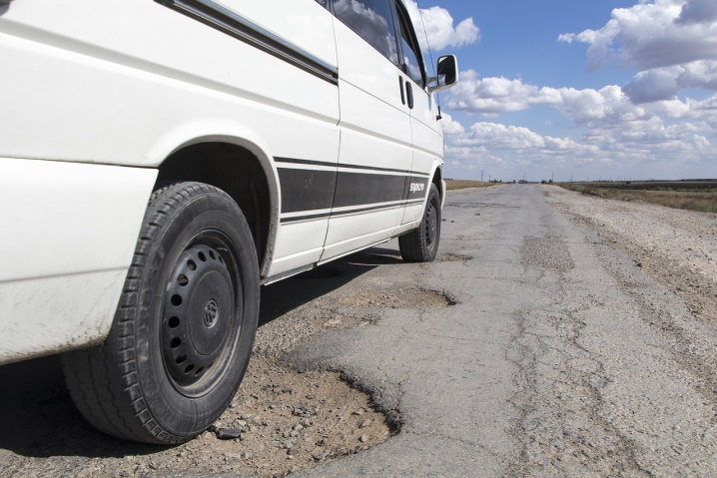
The Blame Game!
QUESTION # 1
Your tire is ruined by hitting a POTHOLE in the road.
Who do you blame??

Slide 5
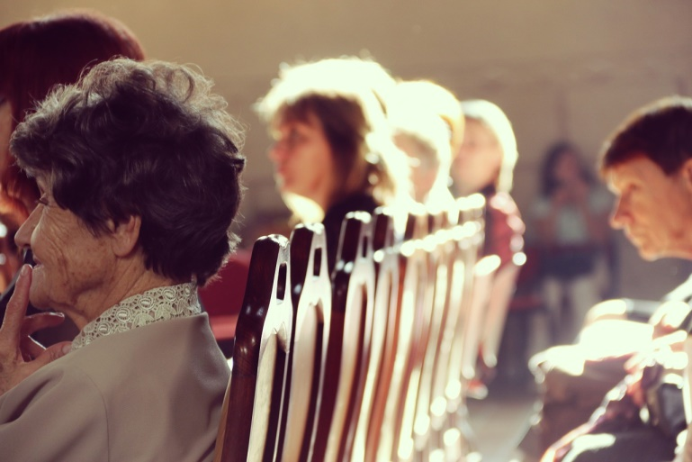
The Blame Game!
QUESTION #2
Fewer participants are attending your Children’s Faith Formation, Youth Ministry or Adult Education.
Who do you blame??

Slide 6
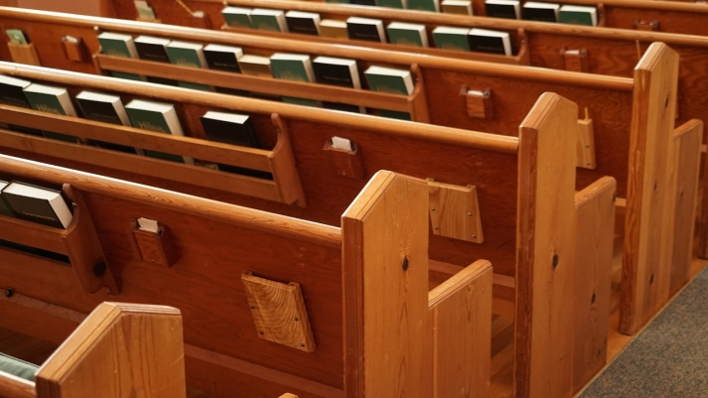
The Blame Game!
QUESTION #3
Fewer people are attending Mass at your parish.
Who do you blame?

Slide 7
Other concerns?
What concerns have you heard from fellow Parish Ministers?
…from people in the pews?
How do we address these concerns?
What are some possible solutions?
How do we turn from BLAME to FLAME of the Holy Spirit?

Slide 8
Scripture, Saint, Shakespeare, or Secular Song?
“A single sunbeam is enough to drive away many shadows.”
SAINT! (Francis of Assisi)

Slide 9
Scripture, Saint, Shakespeare, or Secular Song?
“Out of the mouths of babes”
SCRIPTURE! (Psalm 8)

Slide 10
Scripture, Saint, Shakespeare, or Secular Song?
“Even when you’re sleeping, keep your eyes open”
SONG! (Taylor Swift, “Eyes Open”)

Slide 11
Scripture, Saint, Shakespeare, or Secular Song?
“You’re my end and my beginning.”
SONG! (John Legend “All of Me”)

Slide 12
Scripture, Saint, Shakespeare, or Secular Song?
“Let us eat and drink, for tomorrow we shall die.”
SCRIPTURE! (Isaiah 22)

Slide 13
Scripture, Saint, Shakespeare, or Secular Song?
“What about love? What about trust?”
SONG! (Pink, “What About Us”)

Slide 14
Scripture, Saint, Shakespeare, or Secular Song?
“Let’s go hand in hand, not one before another”
SHAKESPEARE! (Comedy of Errors)

Slide 15
Scripture, Saint, Shakespeare, or Secular Song?
“I am not afraid. I was born to do this”
SAINT! (Joan of Arc)

Slide 16
Scripture, Saint, Shakespeare, or Secular Song?
“It is a wise father that knows his own child.”
SHAKESPEARE! (Merchant of Venice)

